Slide 1
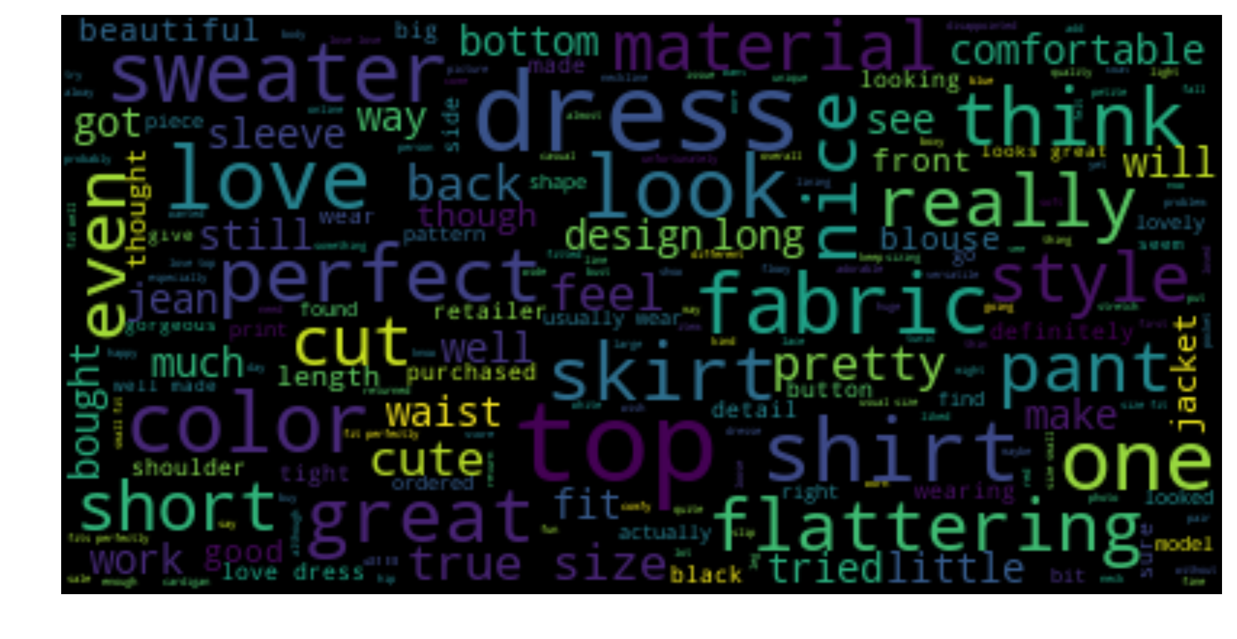
Online Women’s Clothing Review
Kue Ho
Springboard Data Science Career Track

Slide 2
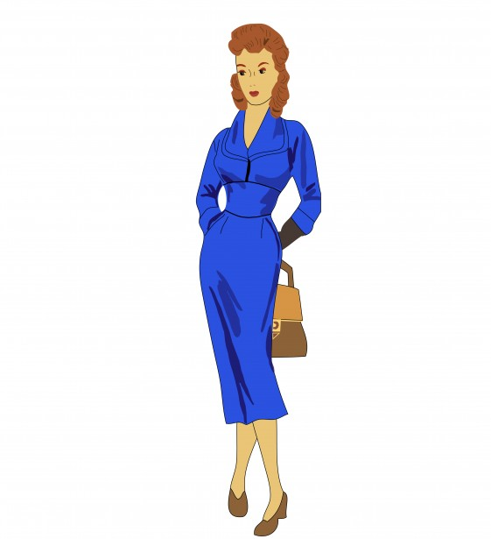
OUTLINE
Introduction
Data Source and Wrangling
Exploratory Data Analysis
Most Reviewed and Recommended Items
Average Positive Feedback per Item
Who are our customers?
Sentiment Analysis
Predictive Analysis
Feature selection
Predict recommendation
Summary
Future Improvements

Slide 3
Introduction
The current reality of the apparel industry is that less and less consumers are frequenting brick and mortar establishments. Customers are finding themselves drawn more towards online shopping and e-commerce for its ease and convenience. A unique problem that is arising from e-commerce, particularly for the apparel industry, is how customers are deciding on specific products without physically seeing, touching, or trying on articles of clothing. As a result, reviews are the go-to resource when making decisions on whether to buy something or not. Reviews are not only important for consumers, but also for any online retail. They rely on reviews to generate interest and profit on a particular item.
Reviews can be extensive and oftentimes contain irrelevant information. Can we compress the data to improve the product? Can we take the reviews and predict whether an item will get recommended or not? From reviews, online retailers can improve the quality of their product to satisfy consumers and increase profit and credibility.

Slide 4
Target Audience
Online Retailers (Amazon, Target, Walmart, Ebay, etc.)
Use this report to improve products and increase profit and credibility.
Online customers
Consider this report as a reference for quality reviews and key words for choosing a product or online retailer.

Slide 5
Data Source and Wrangling
The dataset was gathered from Kaggle website: https://www.kaggle.com/nicapotato/womens-ecommerce-clothing-reviews/version/1
Some of the main features consist of the following: Clothing ID, Age, Review Text, Recommended, Positive Feedback Count, etc..
Since the focus of this project is on review text and clothing items, missing observations were deleted from the following columns: division name, department name, class name and review text. The title column has a significant amount of null data, but it will be left alone for now since it has no direct affect on this project.
A new column was created to label ratings either negative or positive. A negative label meant the rating was less than 3. A positive then consisted of 3 or above.
Final data size: 22,628 entries with 11 columns; size 2.1 MB

Slide 6
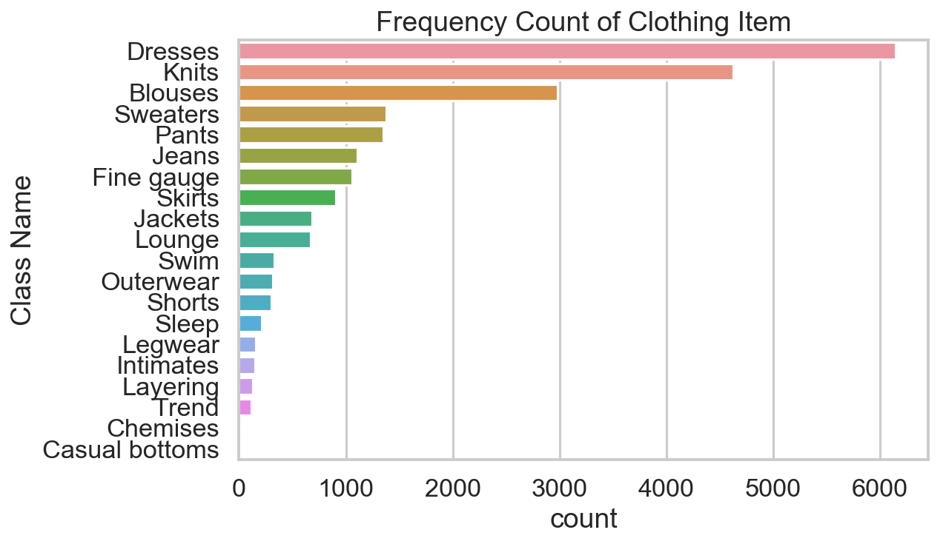
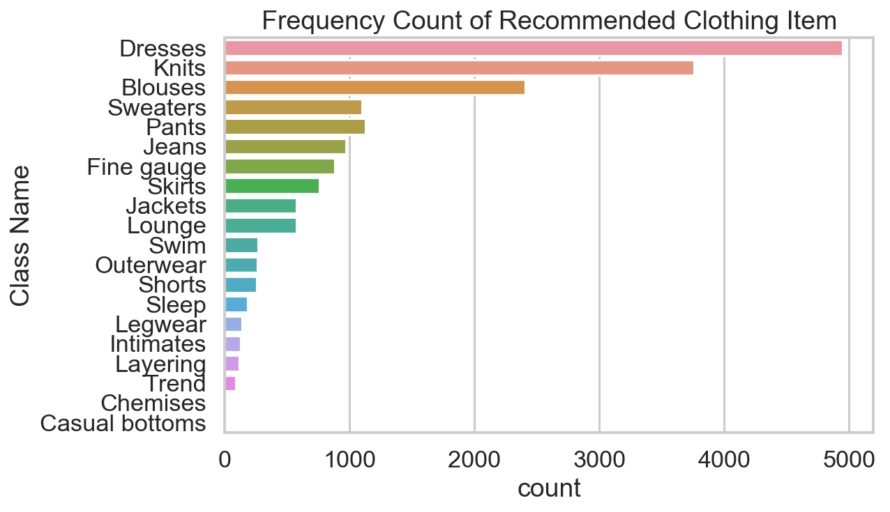
Exploratory Data Analysis
Thoroughly Reviewed and Highly Recommended
The most reviewed and recommended clothing items are dresses, knits and blouses. This indicates that most women buy these items often and they are the most popular items of the online retail. These items help retailers understand what they’re customers want or look for.

Slide 7
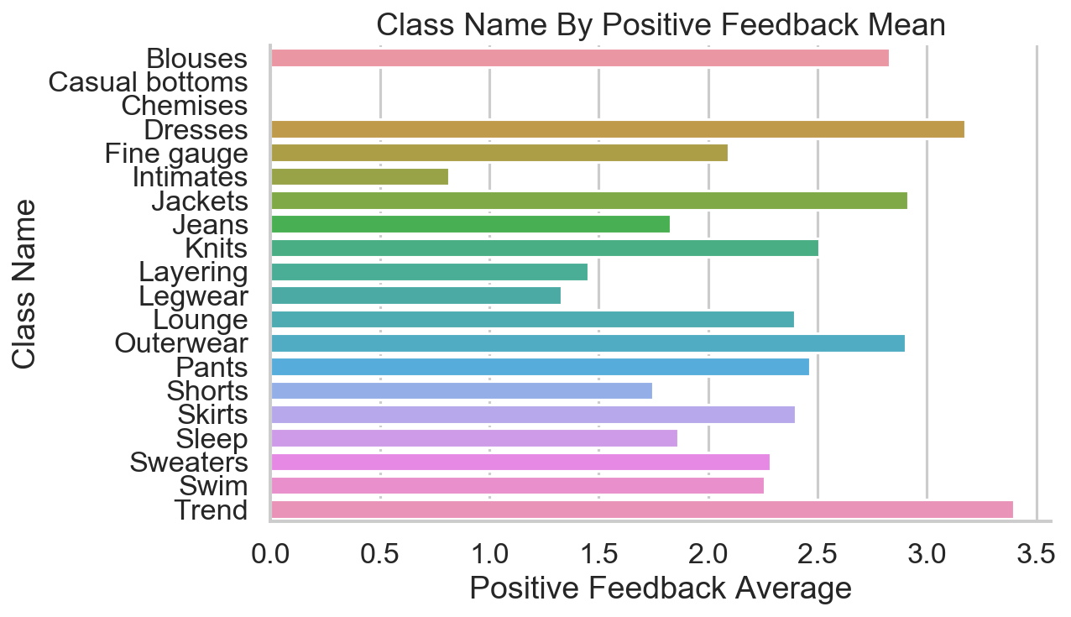
Exploratory Data Analysis - cont.
Do other consumers feel the same way?
Positive feedback is an indication of how other consumers felt about the review text. If other consumers felt the review was useful, then the review received a positive feedback.
Here we look at the average positive feedback of each clothing item. We see that the most reviewed and recommended items (dresses, knits, and blouses) received good average positive feedback. But we also notice that trend received the most positive feedback on average, although it did not get a lot of reviews or recommendations.

Slide 8
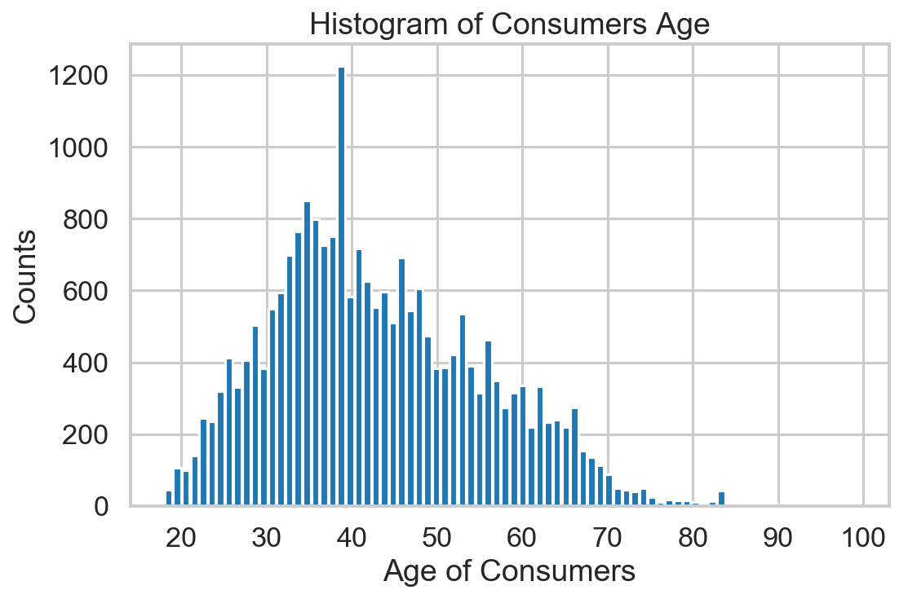
Exploratory Data Analysis - cont.
Who are these consumers?
Overall, we see that the age for women who frequent this online retail ranges from 19 to 85 years old. Majority of these consumers are between the ages 30 - 40. There is an obvious spike around age 40.

Slide 9
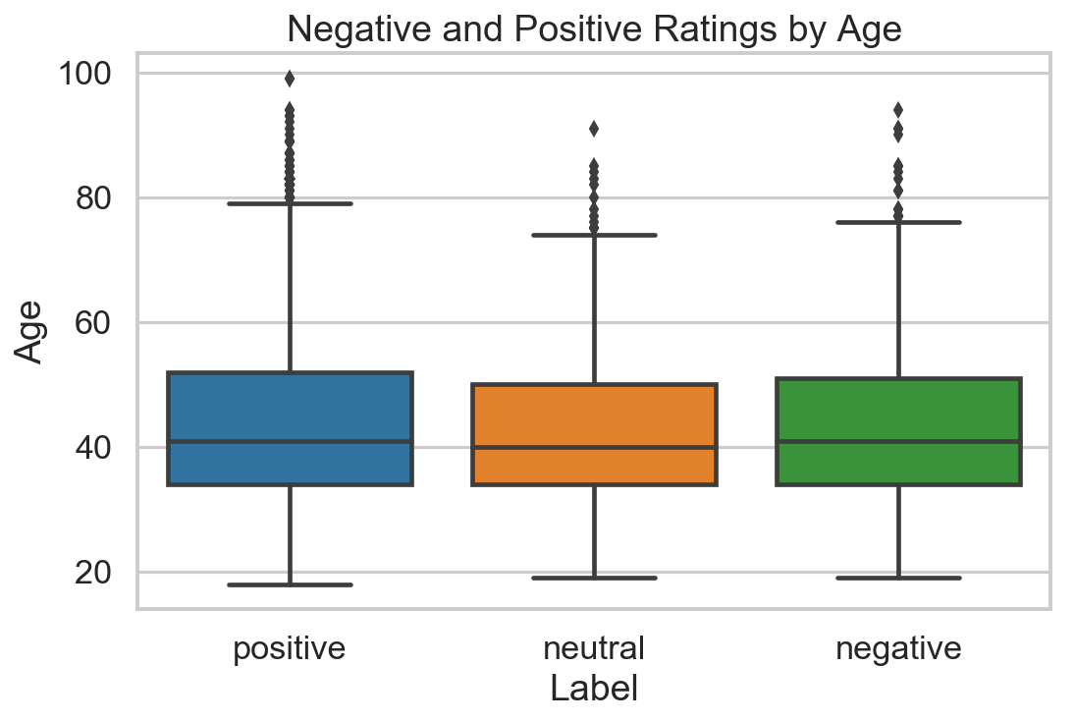
Exploratory Data Analysis - cont.
Does age affect review rating?
The breakdown of review ratings based on age shows that rating sentiment is similar across median age. These ratings are skewed left. The minimum positive rating starts at the youngest age versus neutral and negative ratings.

Slide 10
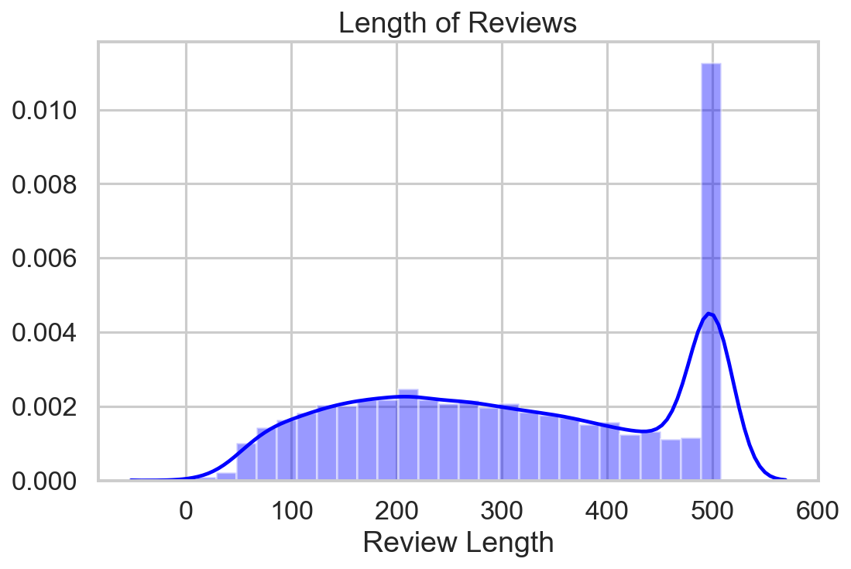
Exploratory Data Analysis - cont.
What’s in a review?
Exploring the review text, we see that the length of review share mainly a unimodal curve except for the hard spike at 500. This indicates that there is a max length of characters allowed for each review and that is 500 characters total.

Slide 11
Sentiment Analysis
Text Preprocessing Steps
Tag POS
Lemmatize
Normalize Text
Tokenization
Apply Model
Lemmatization is a process that reduces tokens to their base word. It is an organized and step by step procedure of obtaining the root form of the word. This technique takes into account context similarity according to part-of-speech anatomy.
Apply parts of speech tag associated with each word in order to find root word.
Lower case all text
Remove stopwords
Find and remove common and rare words
The preprocessed entries are broken down into individual words or token and extracted to make up our corpora.
Run text through
Textblob
Afinn

Slide 12
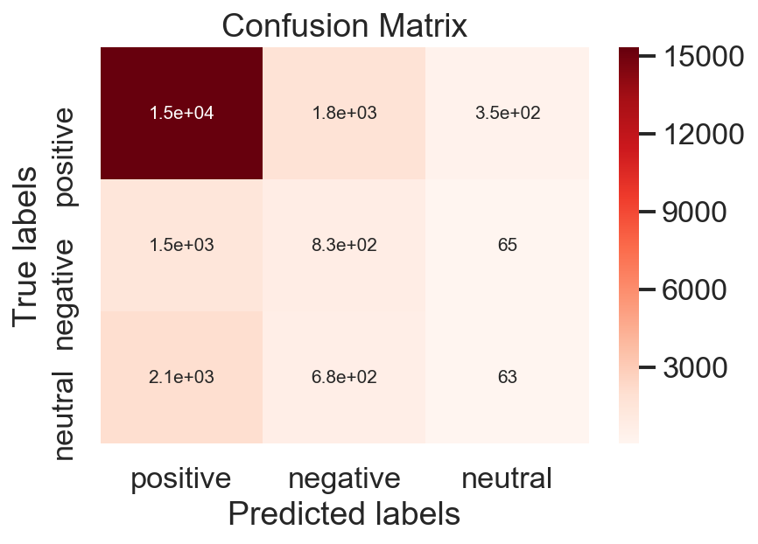
Sentiment Analysis - cont.
Textblob
Most Negative Dress Review: I love this jacket! i was hesitant to order, but i'm so glad i did. it's such a cute, unique blazer to add to my wardrobe. fit is very true to size for a blazer.
Most Positive Dress Review: Like the extra details on the neck and back - and it's versatile to wear everywhere

Slide 13
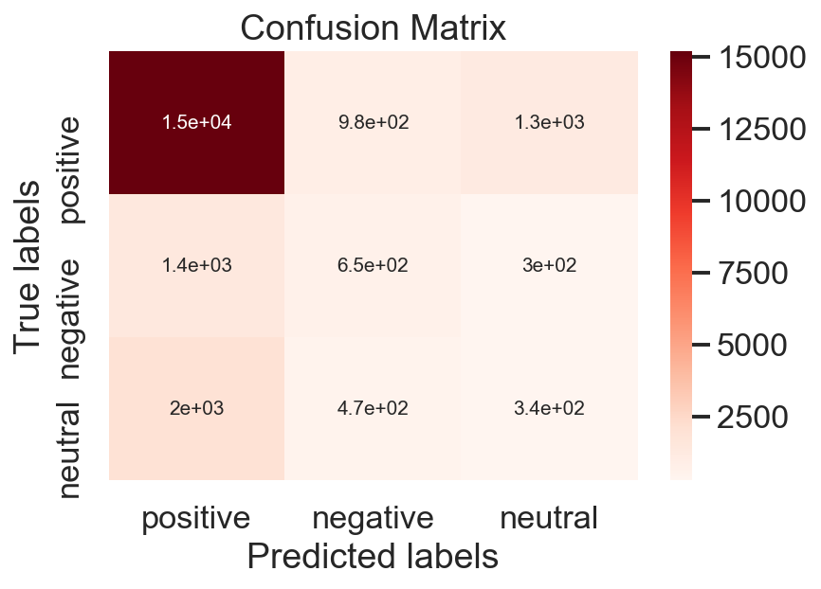
Sentiment Analysis - cont.
Afinn
Most Negative Dress Review: Loved the dress on-line. ordered a petite small. fits perfectly. i am barely 5'5" and carry my weight in hips and thighs. this fits perfectly without being too snug on the butt!! so, if you are a pear shape, get this dress!!
Most Positive Dress Review: Great skirt! i bought the red and paired it with a casual white button down. i feel like the top definitely needs to be short or tucked in for the look to work. i am typically a 2 in bottoms, and went with the small in this. the xs probably fits more like it's intended to, but it is very curve-hugging, and i was more comfortable with the looser fit of the small (especially since i am tucking in a blouse). there is stretch in the skirt, and the fabric has a nice feel.

Slide 14
Sentiment Analysis - cont.
Overall, Afinn is a better sentiment analysis compared to Textblob when using ratings as the ground truth. Although Textblob has a slightly better accuracy score, Afinn is more precise and has a better recall score.
Metric | Textblob | Afinn
Accuracy | 71.7 | 71.4
Precision | 66.8 | 68.3
Recall | 71.1 | 71.4
F1 Score | 68.6 | 69.7

Slide 15
Classification
Predict whether an item will get recommended
Review Text
Train Test Split
Natural Language Processing
Combine
Prepare Target and other feature columns
Feature Selection
(𝝌² & correlation)
𝜶 = 0.05
Oversampling
(SMOTE)
Switch ML models
Compare models
Classification with test data
Parameter Optimization
(Cross-Validation)

Slide 16
Classification - cont.
Natural Language Processing (NLP)
Use NLP matrix with Naive Bayes Classifier to predict consumer recommendation
Accuracy score 0.86 on train and 0.85 test data
Combine TFIDF matrix with the rest of the features and classify using other machine learning models
NLP Flow Chart
Remove punctuation
Remove stopwords
Return a list of cleaned text
Vectorize list
Transform into TFIDF format

Slide 17
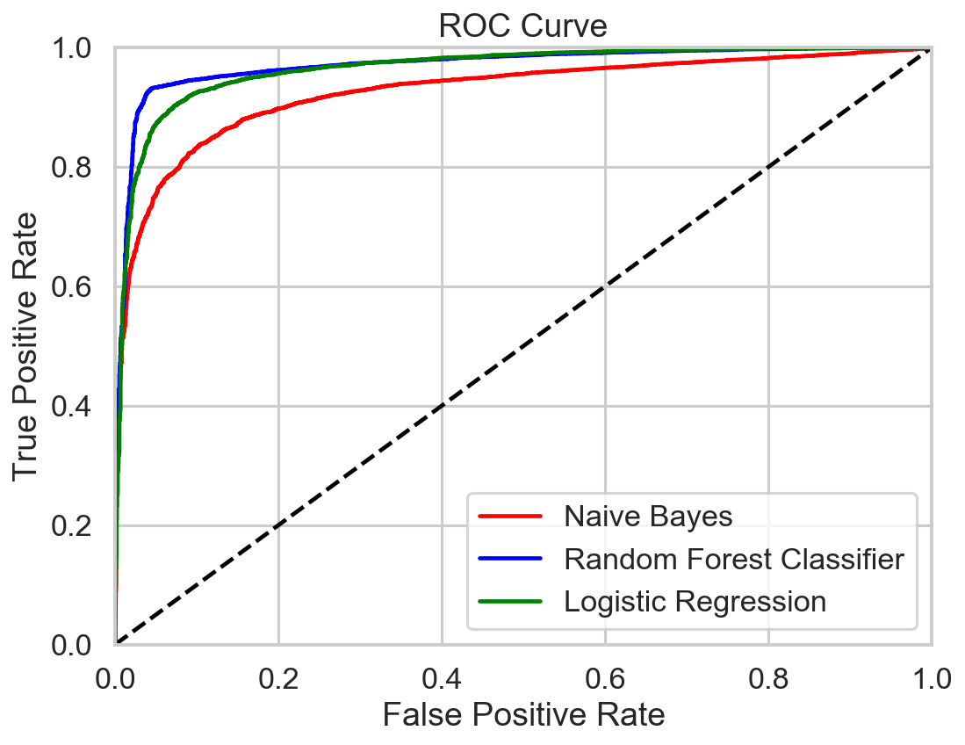
Classification Models
Model | Accuracy score on train | Accuracy score on test
Naive Bayes | 0.864 | 0.883
Random Forest Classifier | 0.958 | 0.937
Logistic Regression | 0.959 | 0.938
Predict Recommendation
Logistic Regression has a slightly higher accuracy score compared to the other two and proves the best model for predicting clothing recommendation.
ROC curve provides a visual of how each model performed. Initially it looks like Random Forest performed better, but if you look closely, you see that Logistic Regression overtook it; having the higher AUC.
Using coefficient of attributes by logistic regression, the top three features with greatest impact on recommendation is positive label, rating and neutral label.

Slide 18
Summary
Dresses, knits, and blouses are the most reviewed and recommended items. On average, they receive pretty good positive feedback as well.
Majority of these female consumers range from ages 30-40; however their age doesn't really show any influence in their clothing ratings.
Overall metrics shows that Afinn is a slightly better sentiment analyzer than Textblob.
Applying sentiment from Afinn and Textblob as part of the many input variables, we see that one with the most influence in the machine learning models are: Label_pos, Rating, Label_neutral, Sent_af_pos, and Sent_tb_pos.
Comparing the three machine learning models (Naive Bayes, Random Forest Classifier, and Logistic Regression), we see that Logistic Regression is the best model for predicting whether these women will recommend an item or not.

